Slide 1
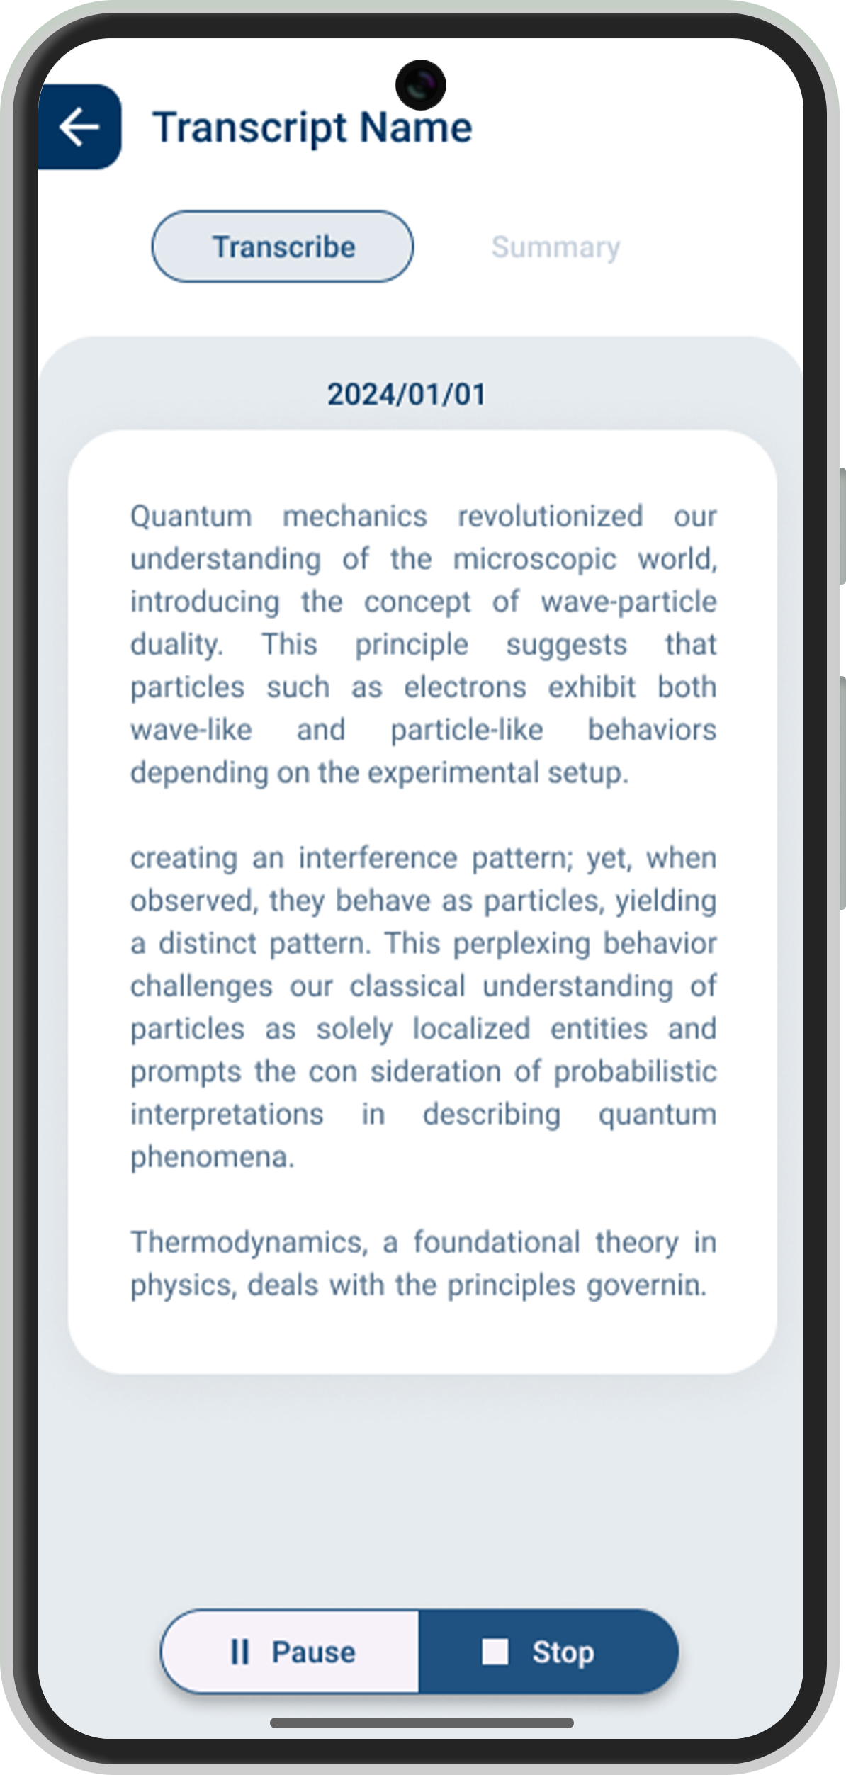
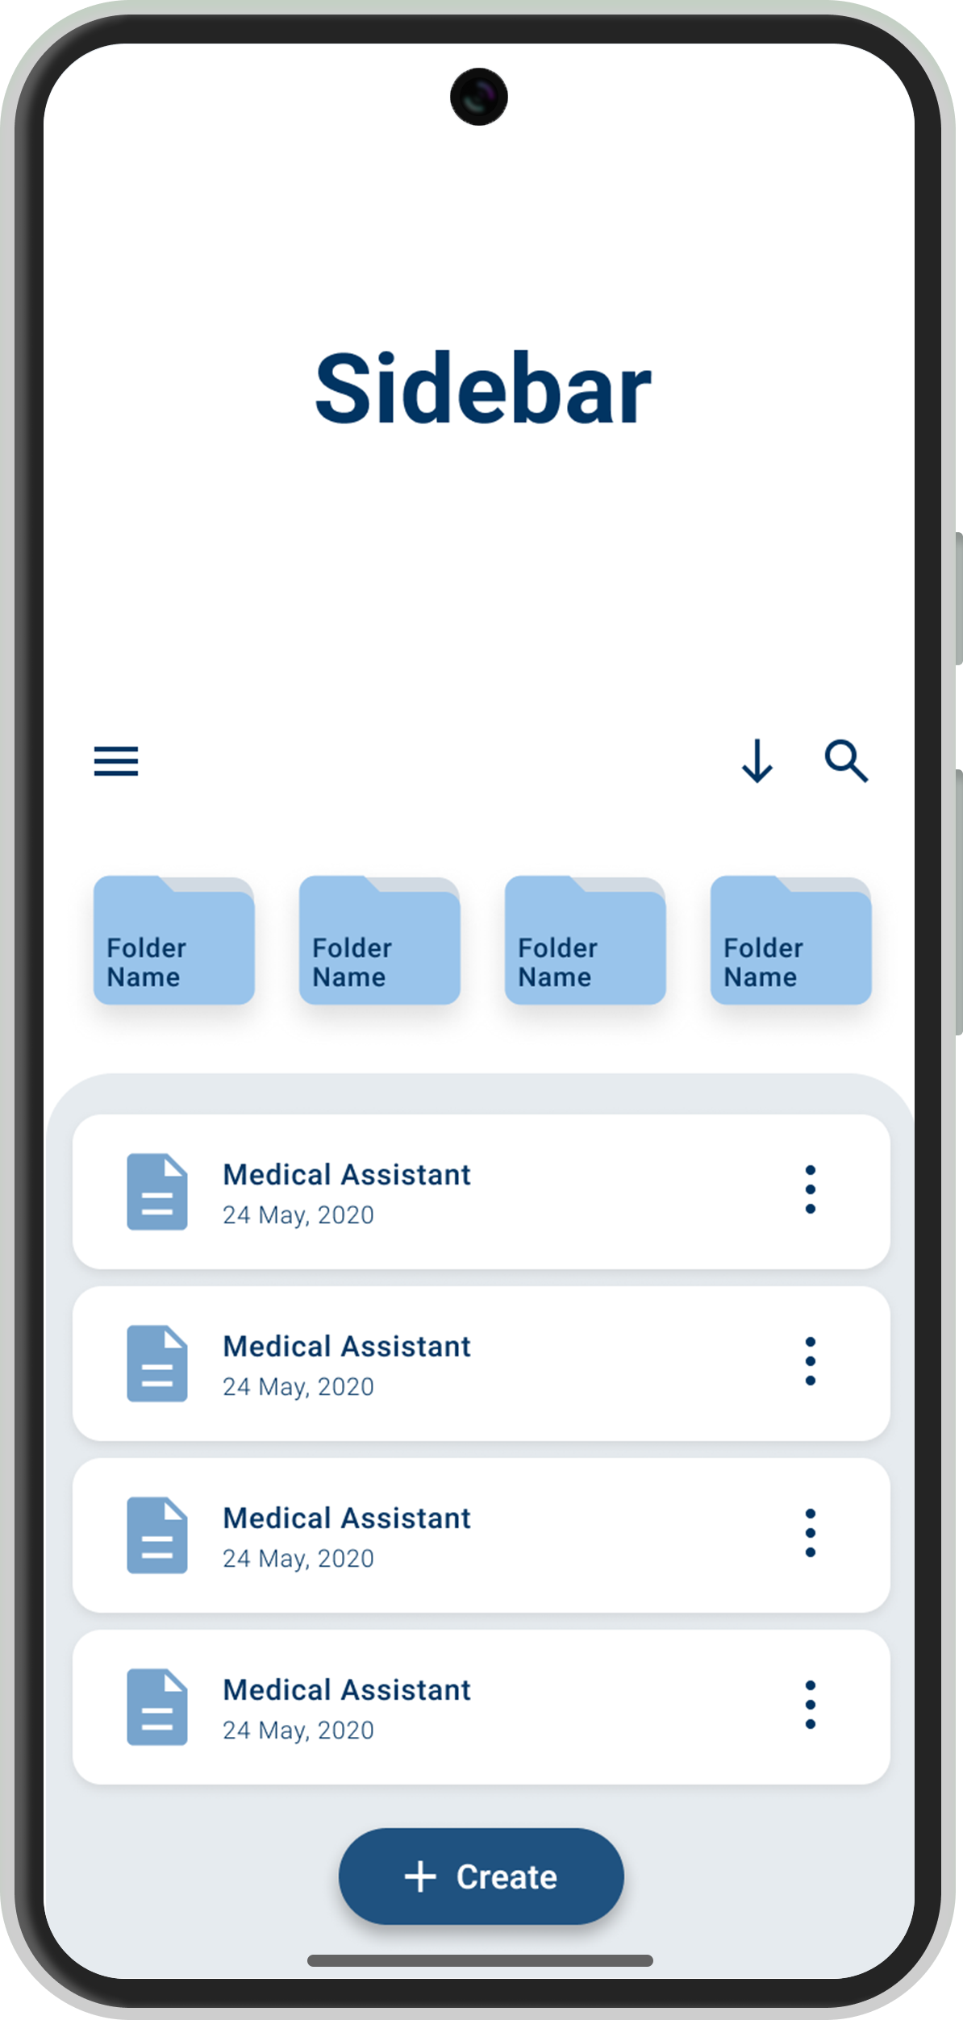
INTRODUCING Sidebar
Your side support for education

Slide 2

INTRODUCING Sidebar
Your side support for education

Slide 3
01
Introduction

Slide 4
What is Sidebar ?
This is a powerful mobile application for Streamlining voice-to-text with a user-friendly interface interconnected with an AI model. There are features that include copy, summarization, and efficient organization through folders and export options by leveraging a Large Language Model (LLM).

Slide 5
Our idea
To provide a powerful mobile application which transcribes the voice in real-time and then by using
Artificial Intelligence (AI) and Large Language Models (LLMs) to explain, summarize, order and create personalized learning content from the transcripts to help undergraduates
in their higher education.

Slide 6
What are the Requirements of Sidebar
07
07
Functional Requirements
Non-Functional Requirements

Slide 7
Functional Requirements
Real-time Transcription
The app must transcribe voice or audio into text in real-time for immediate accessibility.

Slide 8
Functional Requirements
Interactive Text Options
Users can touch and hold on specific text for options such as copying, getting explanations, or creating summaries.

Slide 9
Functional Requirements
Folder Organization
Users can create folders, assign transcribed text to them, and add items to a favorites list for efficient organization.

Slide 10
Functional Requirements
Folder View Interaction
In folder view, users can perform actions like sharing or deleting each transcribed text item by holding on the text.

Slide 11
Functional Requirements
Learn Path Feature
Users can create and customize learning paths, providing a sequential organization for educational purposes.

Slide 12
Functional Requirements
Export Options
Transcribed text can be saved and exported as PDF or Word files, offering versatility in sharing and storage.

Slide 13
Functional Requirements
Sorting Options
Users can sort transcribed text files based on preferences, including date, alphabetical order, or custom criteria.

Slide 14
What are the Requirements of Sidebar
07
07
Functional Requirements
Non-Functional Requirements

Slide 15
Non-Functional Requirements
Performance
The app must provide a seamless and responsive experience with minimal latency during transcription and interactions.

Slide 16
Non-Functional Requirements
Security
Ensure the confidentiality and integrity of transcribed text, implementing robust security measures to protect user data.

Slide 17
Non-Functional Requirements
Compatibility
The app should be compatible with a range of mobile devices and operating systems for widespread accessibility.

Slide 18
Non-Functional Requirements
Usability
The user interface must be intuitive, ensuring ease of use and accessibility for a diverse user base.

Slide 19
Non-Functional Requirements
Reliability
The app should consistently deliver accurate transcriptions and maintain functionality even under varying network conditions.

Slide 20
Non-Functional Requirements
Scalability
The system must be scalable to accommodate potential increases in user base and data volume without compromising performance.

Slide 21
Non-Functional Requirements
Documentation
Comprehensive documentation should be provided for users and developers, aiding in setup, usage, and troubleshooting.

Slide 22
Features of “ Sidebar ”
Real-time Voice Transcription
Learn Path Feature
Instantly converts spoken words into text, providing real-time transcription.
Generate full learning paths for educational content you select.
Interactive Text Options
Folder Organization
Touch and hold on specific text to get additional explanations from LLMs
Create, and manage folders to organize transcribed text efficiently.
Transcripts Summaries
Export to PDF / Word
Create and attach custom summaries generated by LLMs for enhanced context.
Save and export transcribed text as PDF or Word files for versatile sharing and storage.
Artificial Intelligence Integrated
Integrated GPT models to perform special tasks like summarization and explanation.

Slide 24
Target Audience Profiling
Undergraduate Students
Demographics :
Age : Children aged 18 – 30
Gender : Any
Social Backgrounds : Diverse social backgrounds, but has a background of using English language for their education
Region : Worldwide
Education : Tertiary Education
Job : Student

Slide 25
User Flow Diagram
Click here to view on Figma

Slide 26
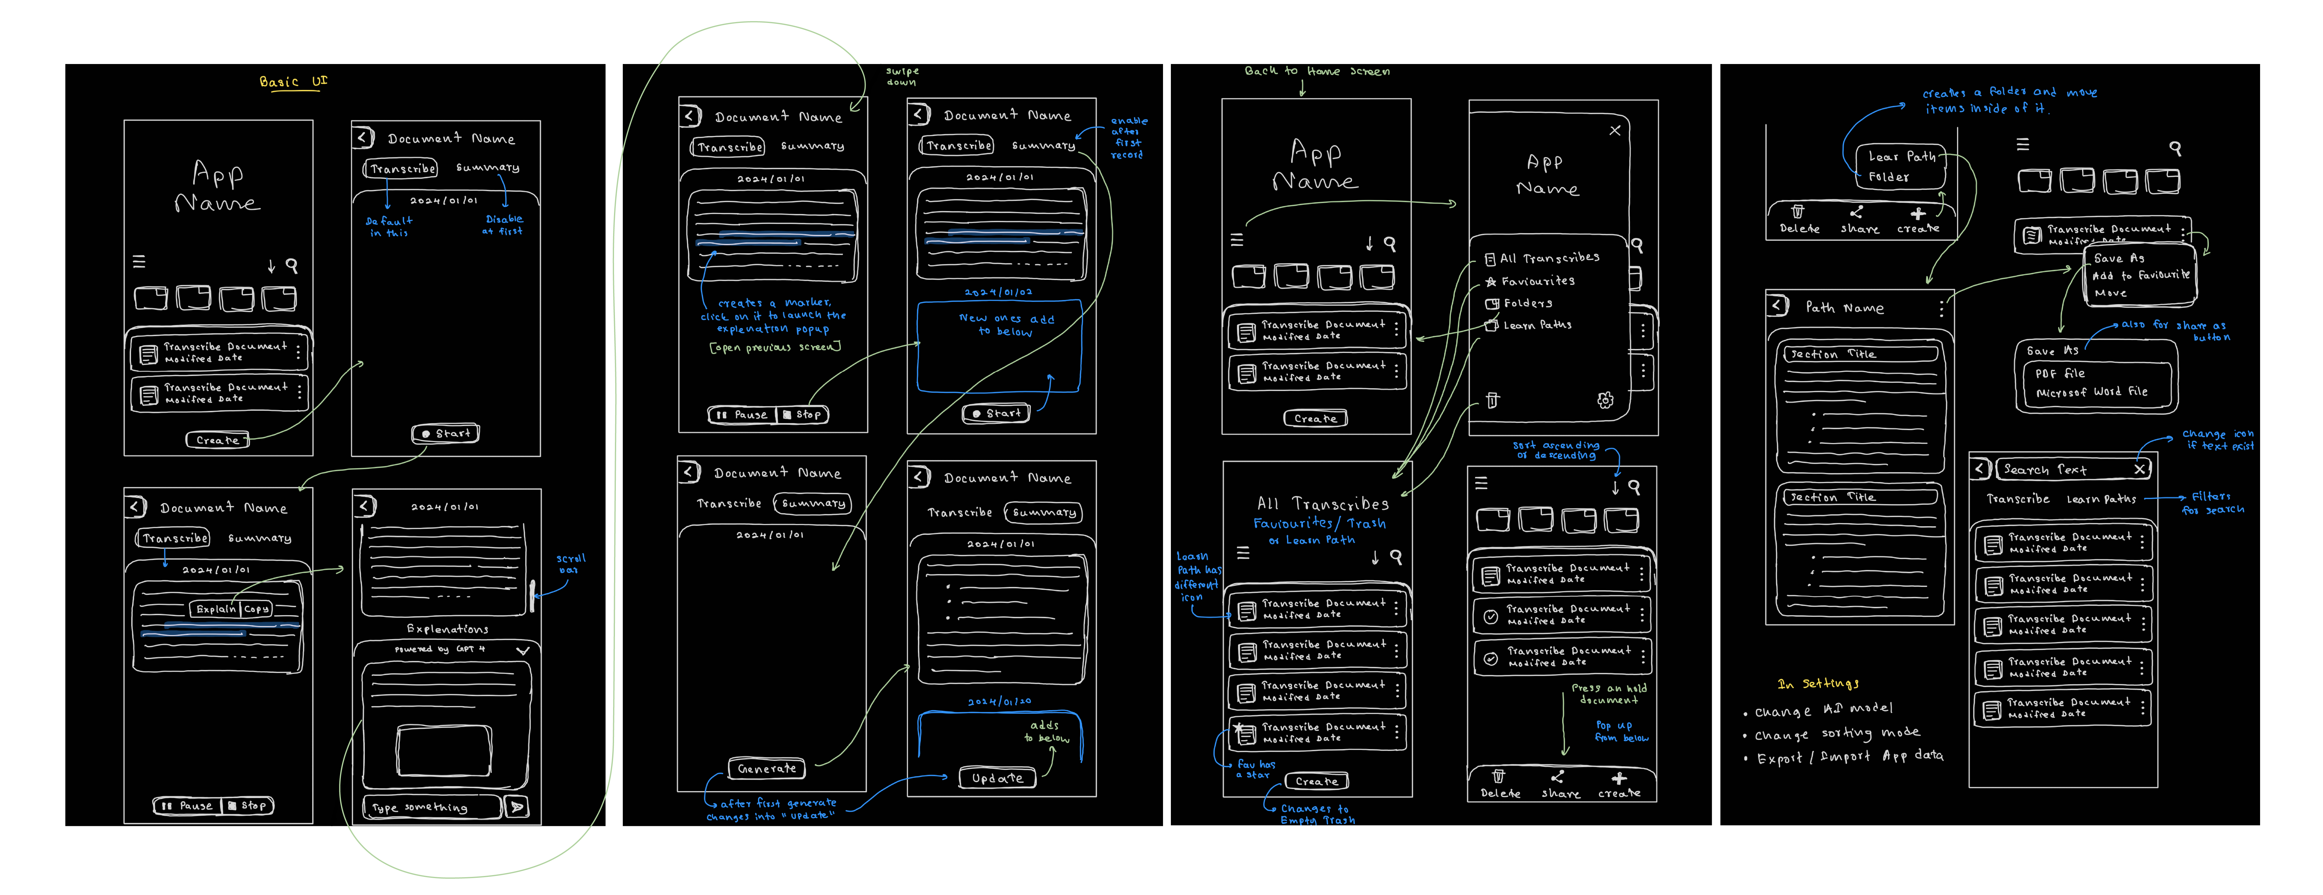
Wireframe Design

Slide 27
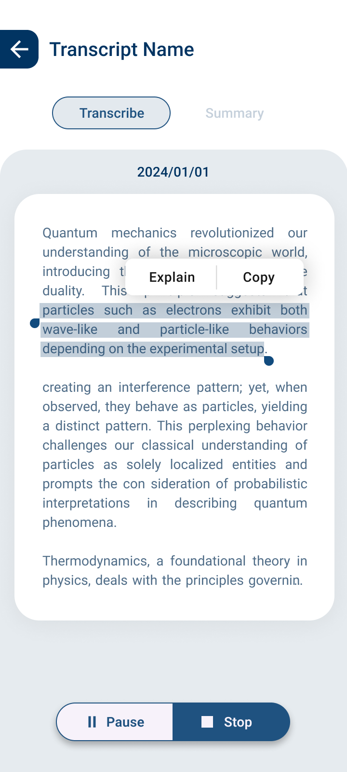
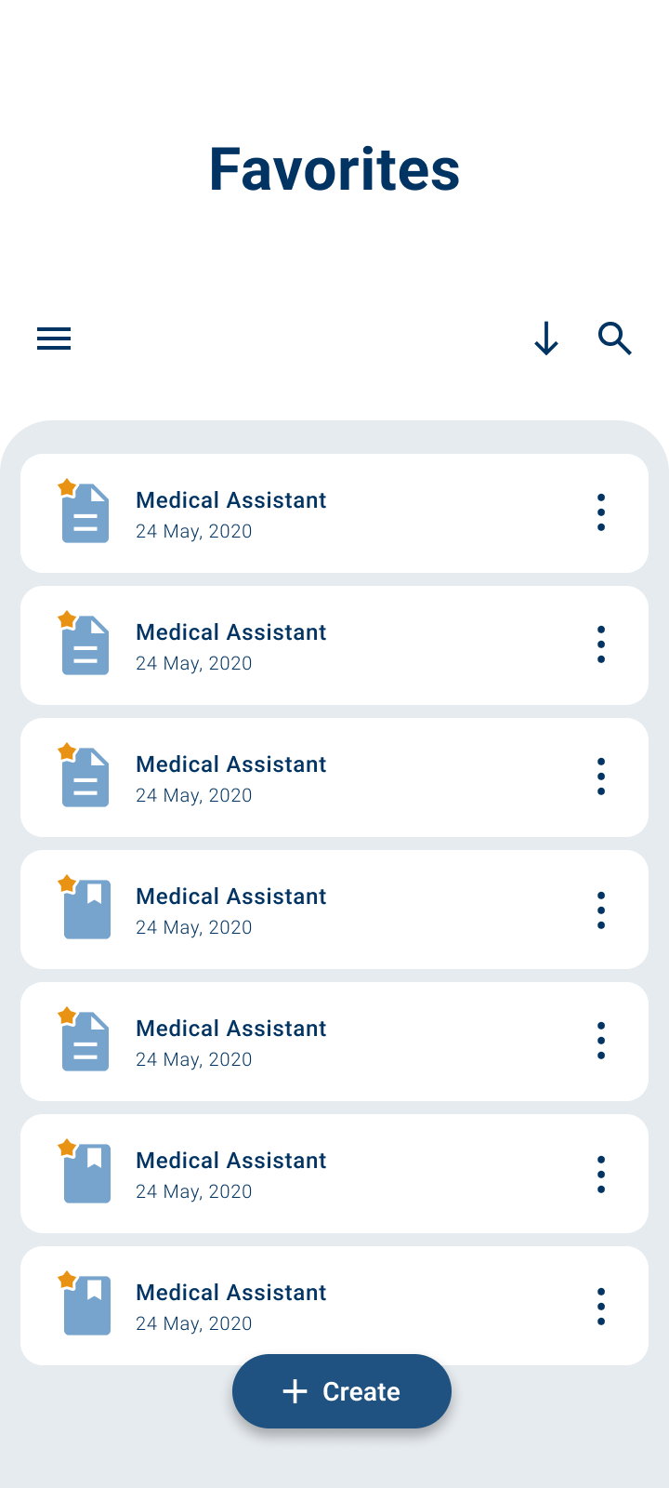
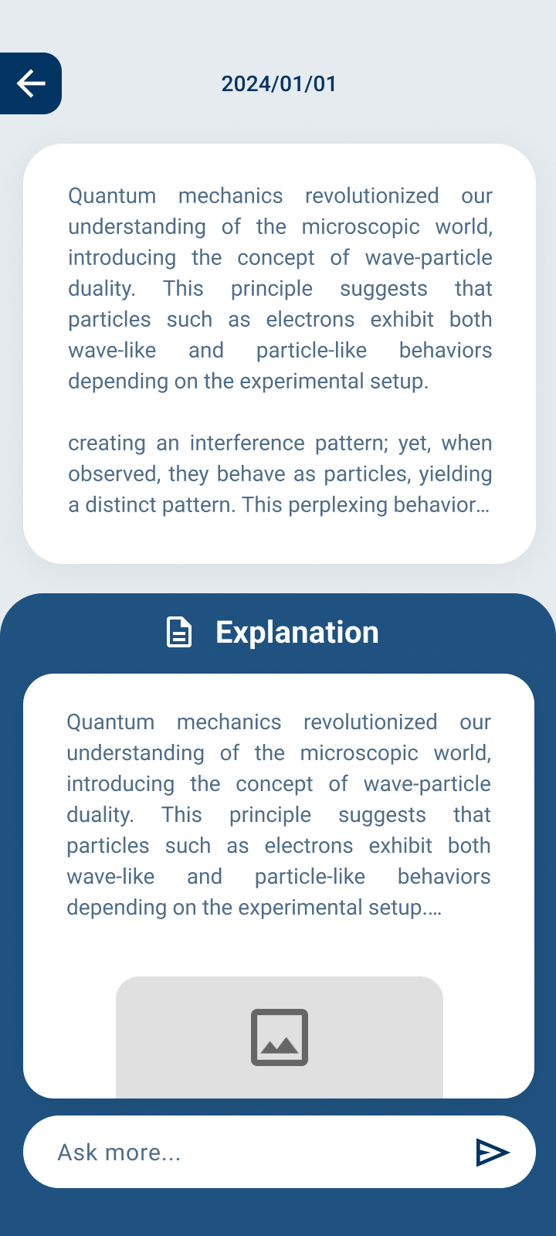
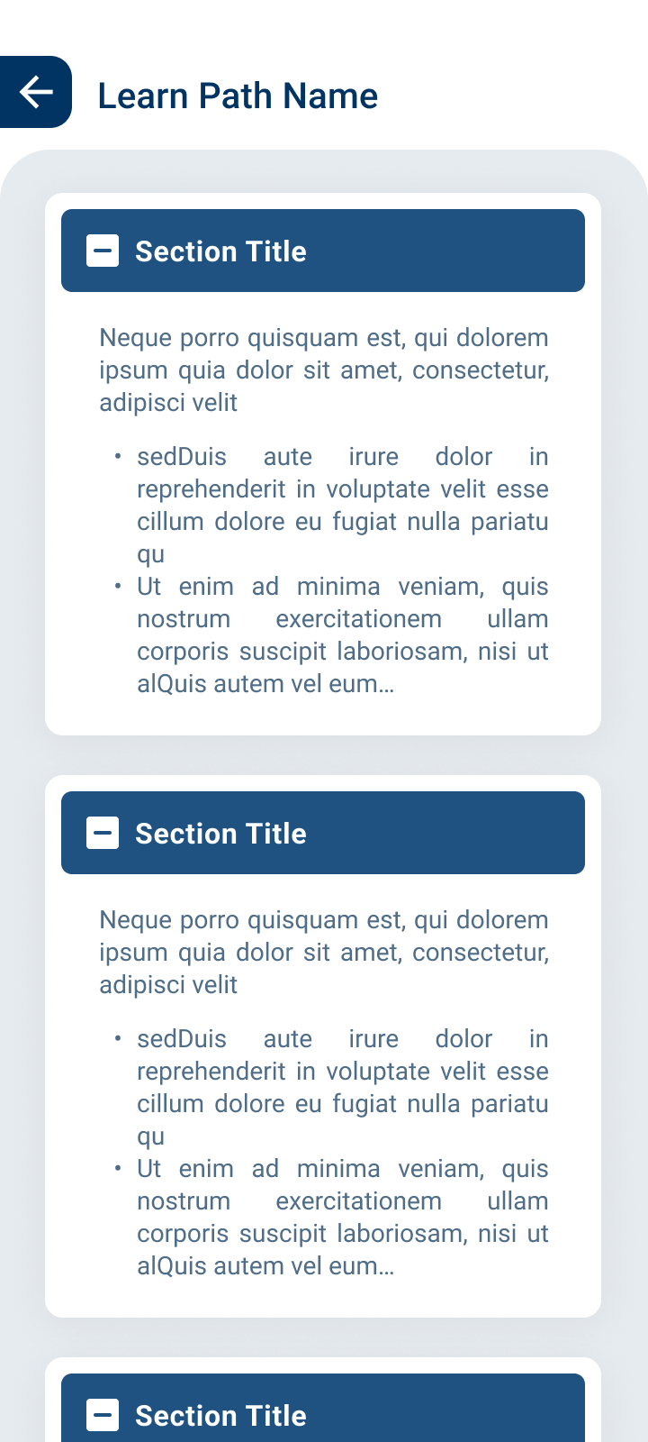
App UI Design

Slide 28


Team Members
01
02
03
04
Vinura Gallage
Dilshan Gamage
Nadeera Udayanga
Shavindu Thushara
University of Sri Jayewardenepura

Slide 29
Thank You!

